Slide 2
Lecture Outline
Modern Block Ciphers
Block Vs Stream Ciphers
Confusion and Diffusion
Feistal Cipher Structure
Data Encryption Standard (DES)
Avalanche Effect
Strength of DES – Timing Attacks
Mode of Operations (ECB, CBC)

Slide 3
Modern Block Ciphers
will now look at modern block ciphers
one of the most widely used types of cryptographic algorithms
provide secrecy and/or authentication services
in particular will introduce DES (Data Encryption Standard)

Slide 4
Block vs Stream Ciphers
Block Ciphers process messages in into blocks, each of which is then en/decrypted
like a substitution on very big characters
64-bits or more
Stream Ciphers process messages a bit or byte at a time when en/decrypting
many current ciphers are block ciphers
hence are focus of course

Slide 5
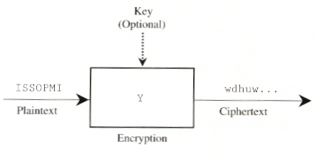
Block Cipher Systems
5

Slide 6
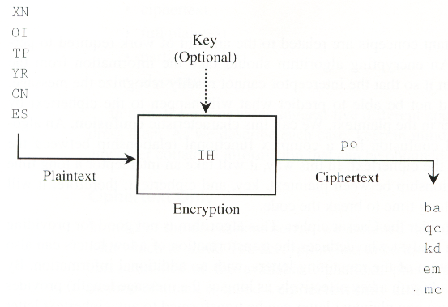
Block Cipher Systems
6

Slide 7
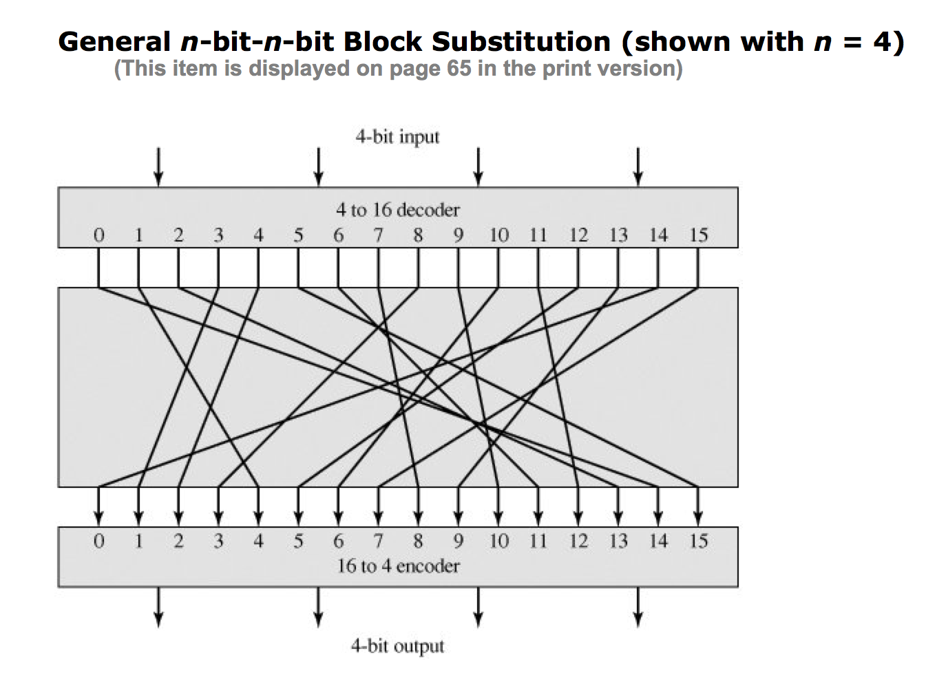
General n-bit-n-bit Block Substitution (n=4)
Notes:
If a small block size, such as n = 4, is used, then the system is equivalent to a classical substitution cipher. Such systems, as we have seen, are vulnerable to a statistical analysis of the plaintext. This weakness is not inherent in the use of a substitution cipher but rather results from the use of a small block size. If n is sufficiently large and an arbitrary reversible substitution between plaintext and ciphertext is allowed, then the statistical characteristics of the source plaintext are masked to such an extent that this type of cryptanalysis is infeasible

Slide 8
Block Cipher Principles
most symmetric block ciphers are based on a Feistel Cipher Structure
needed since must be able to decrypt ciphertext to recover messages efficiently
block ciphers look like an extremely large substitution
would need table of 2⁶⁴ entries for a 64-bit block
instead create from smaller building blocks
using idea of a product cipher
Notes:
An arbitrary reversible substitution cipher for a large block size is not practical, however, from an implementation and performance point of view. In general, for an n-bit general substitution block cipher, the size of the key is n x 2^{n}. For a 64-bit block, which is a desirable length to thwart statistical attacks, the key size is 64 x 2⁶⁴ = 2⁷⁰ = 10²¹ bits.
Symmetric: same key is used for enc/decry

Slide 9
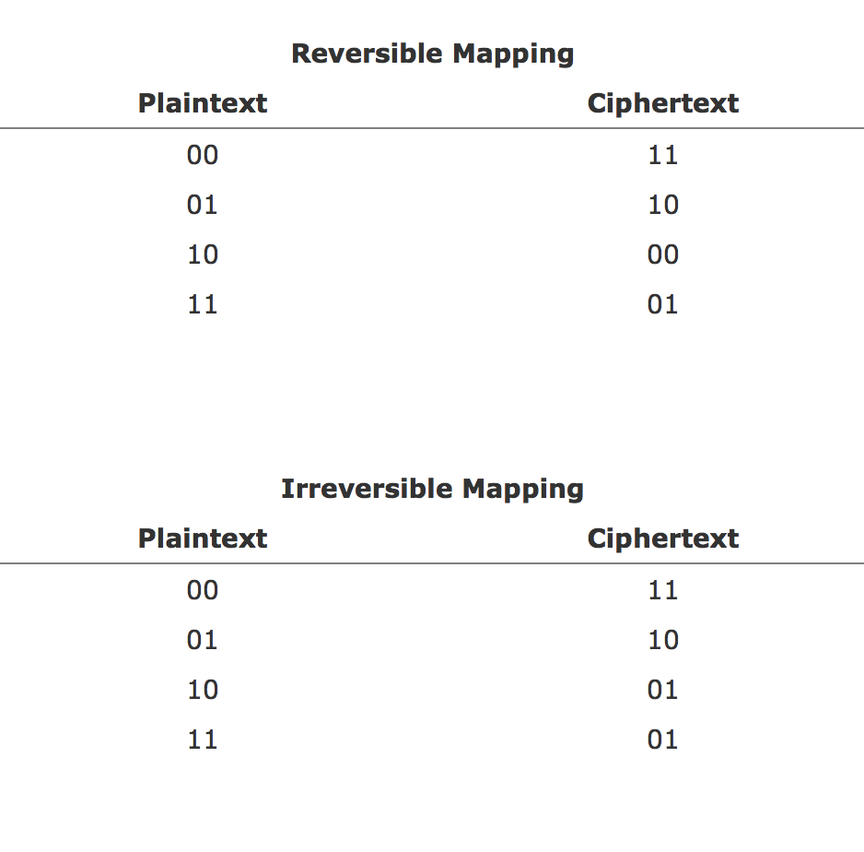
Reverse Vs. Irreversible

Slide 10
Claude Shannon and Substitution-Permutation Ciphers
in 1949 Claude Shannon introduced idea of substitution-permutation (S-P) networks
modern substitution-transposition product cipher
these form the basis of modern block ciphers
S-P networks are based on the two primitive cryptographic operations we have seen before:
substitution (S-box)
permutation (P-box)
provide confusion and diffusion of message
Notes:
Claude Shannon’s 1949 paper has the key ideas that led to the development of modern block ciphers. Critically, it was the technique of layering groups of S-boxes separated by a larger P-box to form the S-P network, a complex form of a product cipher. He also introduced the ideas of confusion and diffusion, notionally provided by S-boxes and P-boxes (in conjunction with S-boxes).

Slide 11
Confusion and Diffusion
cipher needs to completely obscure statistical properties of original message
a one-time pad does this
more practically Shannon suggested combining elements to obtain:
Diffusion – dissipates statistical structure of plaintext over bulk of ciphertext
Confusion – makes relationship between ciphertext and key as complex as possible
Notes:
Every block cipher involves a transformation of a block of plaintext into a block of ciphertext, where the transformation depends on the key. The mechanism of diffusion seeks to make the statistical relationship between the plaintext and ciphertext as complex as possible in order to thwart attempts to deduce the key. confusion seeks to make the relationship between the statistics of the ciphertext and the value of the encryption key as complex as possible, again to thwart attempts to discover the key.
So successful are diffusion and confusion in capturing the essence of the desired attributes of a block cipher that they have become the cornerstone of modern block cipher design.

Slide 12
Feistel Cipher Structure
Horst Feistel devised the feistel cipher
based on concept of invertible product cipher
partitions input block into two halves
process through multiple rounds which
perform a substitution on left data half
based on round function of right half & subkey
then have permutation swapping halves
implements Shannon’s substitution-permutation network concept
Notes:
Horst Feistel, working at IBM Thomas J Watson Research Labs devised a suitable invertible cipher structure in early 70's.
One of Feistel's main contributions was the invention of a suitable structure which adapted Shannon's S-P network in an easily inverted structure. Essentially the same h/w or s/w is used for both encryption and decryption, with just a slight change in how the keys are used. One layer of S-boxes and the following P-box are used to form the round function.

Slide 13
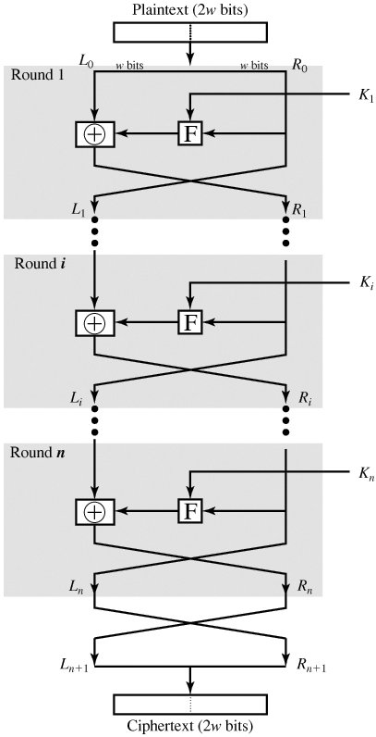
Fiestel Cipher Structure

Slide 14
Feistel Cipher Design Principles
block size
increasing size improves security, but slows cipher
key size
increasing size improves security, makes exhaustive key searching harder, but may slow cipher
number of rounds
increasing number improves security, but slows cipher
subkey generation
greater complexity can make analysis harder, but slows cipher
round function
greater complexity can make analysis harder, but slows cipher
fast software en/decryption & ease of analysis
are more recent concerns for practical use and testing

Slide 15
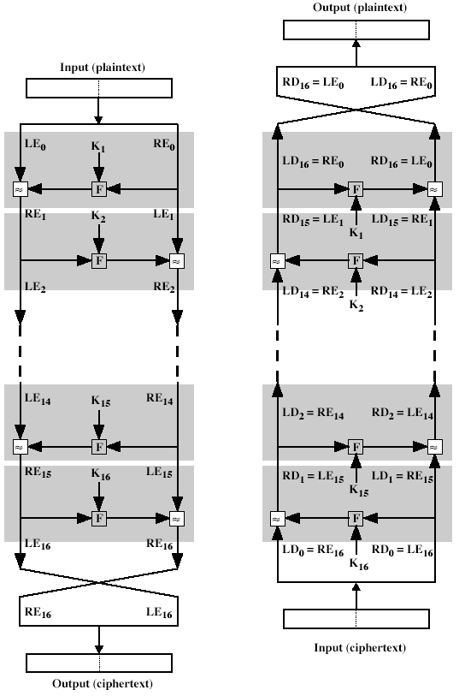
Data Encryption Standard (DES)
Same process as encryption.
Use the ciphertext as input to the algorithm, but use the subkeys Ki in reverse order. i.e. use Kn in the first round, Kn–1 in the second round, and so on until K1 is used in the last round.
NO need to implement two different alogrithms for encryption and decryption.

Slide 16
Data Encryption Standard (DES)
most widely used block cipher in world
adopted in 1977 by NBS (now NIST)
as FIPS PUB 46
encrypts 64-bit data using 56-bit key
has widespread use
has been considerable controversy over its security

Slide 17
DES History
IBM developed Lucifer cipher
by team led by Feistel
used 64-bit data blocks with 128-bit key
then redeveloped as a commercial cipher with input from NSA and others
in 1973 NBS issued request for proposals for a national cipher standard
IBM submitted their revised Lucifer which was eventually accepted as the DES

Slide 18
DES Design Controversy
although DES standard is public
was considerable controversy over design
in choice of 56-bit key (vs Lucifer 128-bit)
and because design criteria were classified
subsequent events and public analysis show in fact design was appropriate
DES has become widely used, esp in financial applications
1977-1998 US Standard
Best studied cipher in the world
Notes:
Recent analysis has shown despite this controversy, that DES is well designed. DES is theoretically broken using Differential or Linear Cryptanalysis
but in practise is unlikely to be a problem yet. Also rapid advances in computing speed though have rendered the 56 bit key susceptible to exhaustive key search, as predicted by Diffie & Hellman. Have demonstrated breaks:
- 1997 on a large network of computers in a few months
- 1998 on dedicated h/w (EFF) in a few days
1999 above combined in 22hrs!
E-passport use DES (triple des)

Slide 19
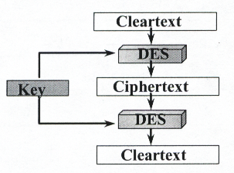
DES Algorithm

Slide 20
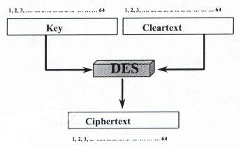
DES Properties

Slide 21
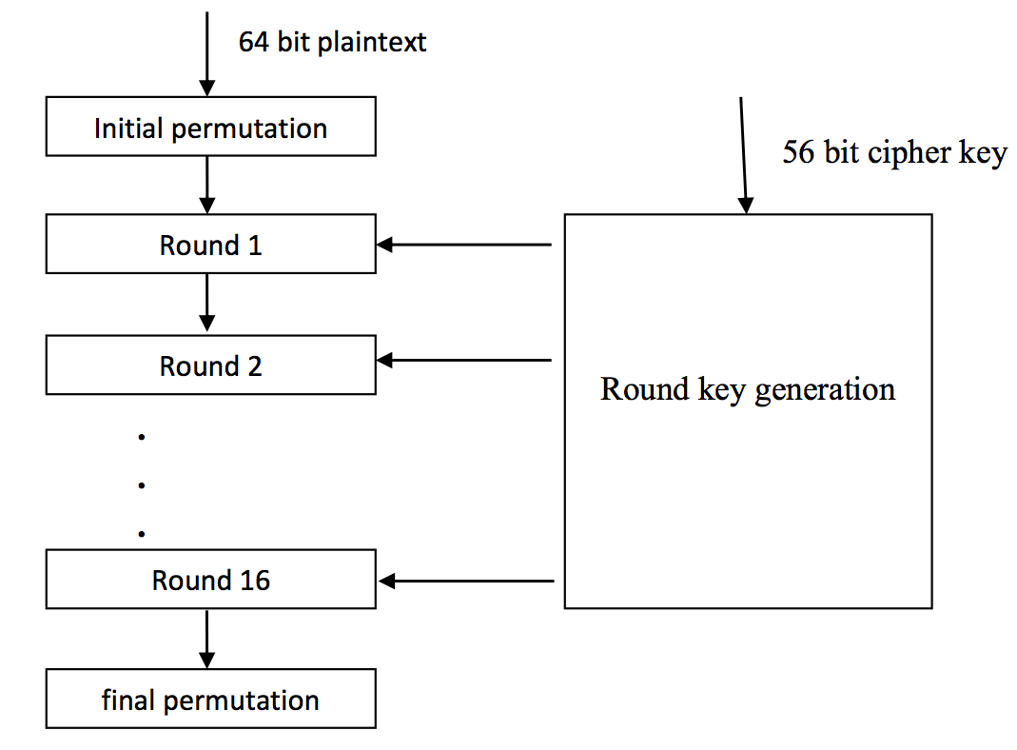
DES - Working Principle

Slide 22
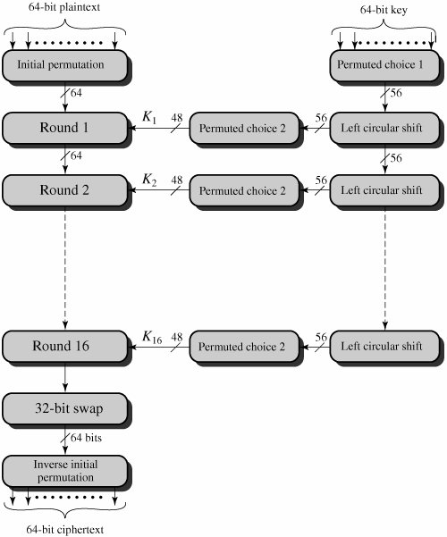
DES Encryption
22
Notes:
The basic process in enciphering a 64-bit data block using the DES, shown on the left side, consists of:
- an initial permutation (IP)
- 16 rounds of a complex key dependent round function involving substitution and permutation functions
- a final permutation, being the inverse of IP
The right side shows the handling of the 56-bit key and consists of:
- an initial permutation of the key (PC1) which selects 56-bits in two 28-bit halves
- 16 stages to generate the subkeys using a left circular shift and a permutation

Slide 23
Initial Permutation IP
first step of the data computation
IP reorders the input data bits
even bits to LH half, odd bits to RH half
quite regular in structure (easy in h/w)
23
Notes:
The initial permutation and its inverse are defined by tables, as shown in Tables 3.2a and 3.2b, respectively. The tables are to be interpreted as follows. The input to a table consists of 64 bits numbered from 1 to 64. The 64 entries in the permutation table contain a permutation of the numbers from 1 to 64. Each entry in the permutation table indicates the position of a numbered input bit in the output, which also consists of 64 bits.
Note that the bit numbering for DES reflects IBM mainframe practice, and is the opposite of what we now mostly use - so be careful! Numbers from Bit 1 (leftmost, most significant) to bit 32/48/64 etc (rightmost, least significant).
Note that examples are specified using hexadecimal.

Slide 24
Initial Permutation IP& Inverse Initial Permutation (IP¹)
(a) Initial Permutation (IP)
58 | 50 | 42 | 34 | 26 | 18 | 10 | 2
60 | 52 | 44 | 36 | 28 | 20 | 12 | 4
62 | 54 | 46 | 38 | 30 | 22 | 14 | 6
64 | 56 | 48 | 40 | 32 | 24 | 16 | 8
57 | 49 | 41 | 33 | 25 | 17 | 9 | 1
59 | 51 | 43 | 35 | 27 | 19 | 11 | 3
61 | 53 | 45 | 37 | 29 | 21 | 13 | 5
63 | 55 | 47 | 39 | 31 | 23 | 15 | 7
(b) Inverse Initial Permutation (IP¹)
40 | 8 | 48 | 16 | 56 | 24 | 64 | 32
39 | 7 | 47 | 15 | 55 | 23 | 63 | 31
38 | 6 | 46 | 14 | 54 | 22 | 62 | 30
37 | 5 | 45 | 13 | 53 | 21 | 61 | 29
36 | 4 | 44 | 12 | 52 | 20 | 60 | 28
35 | 3 | 43 | 11 | 51 | 19 | 59 | 27
34 | 2 | 42 | 10 | 50 | 18 | 58 | 26
33 | 1 | 41 | 9 | 49 | 17 | 57 | 25

Slide 25
M₁ | M₂ | M₃ | M₄ | M₅ | M₆ | M₇ | M₈
M₉ | M₁₀ | M₁₁ | M₁₂ | M₁₃ | M₁₄ | M₁₅ | M₁₆
M₁₇ | M₁₈ | M₁₉ | M₂₀ | M₂₁ | M₂₂ | M₂₃ | M₂₄
M₂₅ | M₂₆ | M₂₇ | M₂₈ | M₂₉ | M₃₀ | M₃₁ | M₃₂
M₃₃ | M₃₄ | M₃₅ | M₃₆ | M₃₇ | M₃₈ | M₃₉ | M₄₀
M₄₁ | M₄₂ | M₄₃ | M₄₄ | M₄₅ | M₄₆ | M₄₇ | M₄₈
M₄₉ | M₅₀ | M₅₁ | M₅₂ | M₅₃ | M₅₄ | M₅₅ | M₅₆
M₅₇ | M₅₈ | M₅₉ | M₆₀ | M₆₁ | M₆₂ | M₆₃ | M₆₄
M₅₈ | M₅₀ | M₄₂ | M₃₄ | M₂₆ | M₁₈ | M₁₀ | M₂
M₆₀ | M₅₂ | M₄₄ | M₃₆ | M₂₈ | M₂₀ | M₁₂ | M₄
M₆₂ | M₅₄ | M₄₆ | M₃₈ | M₃₀ | M₂₂ | M₁₄ | M₆
M₆₄ | M₅₆ | M₄₈ | M₄₀ | M₃₂ | M₂₄ | M₁₆ | M₈
M₅₇ | M₄₉ | M₄₁ | M₃₃ | M₂₅ | M₁₇ | M₉ | M₁
M₅₉ | M₅₁ | M₄₃ | M₃₅ | M₂₇ | M₁₉ | M₁₁ | M₃
M₆₁ | M₅₃ | M₄₅ | M₃₇ | M₂₉ | M₂₁ | M₁₃ | M₅
M₆₃ | M₅₅ | M₄₇ | M₃₉ | M₃₁ | M₂₃ | M₁₅ | M₇

Slide 26
Expansion Permutation & Permutation Function Box
(c) Expansion Permutation (E)
 | 32 | 1 | 2 | 3 | 4 | 5
 | 4 | 5 | 6 | 7 | 8 | 9
 | 8 | 9 | 10 | 11 | 12 | 13
 | 12 | 13 | 14 | 15 | 16 | 17
 | 16 | 17 | 18 | 19 | 20 | 21
 | 20 | 21 | 22 | 23 | 24 | 25
 | 24 | 25 | 26 | 27 | 28 | 29
 | 28 | 29 | 30 | 31 | 32 | 1
(d) Permutation Function (P)
16 | 7 | 20 | 21 | 29 | 12 | 28 | 17
1 | 15 | 23 | 26 | 5 | 18 | 31 | 10
2 | 8 | 24 | 14 | 32 | 27 | 3 | 9
19 | 13 | 30 | 6 | 22 | 11 | 4 | 25

Slide 27
Single Round of DES
32 bits
32 bits
28 bits
28 bits
Li-1
Ri-1
Ci-1
Di-1
Expansion
E-table
Left Shift(s)
Right Shift(s)
48
XOR
Permutation/
Contraction
F
48
Ki
48
Substitution
/choice
(s-box)
32
Permutation (P)
32
XOR
Li
Ri
Ci
Di
27

Slide 28
DES Round Structure
uses two 32-bit L & R halves
as for any Feistel cipher can describe as:
L_{i} = R_{i–1}
R_{i} = L_{i–1} xor F(R_{i–1}, K_{i})
takes 32-bit R half and 48-bit subkey and:
expands R to 48-bits using perm E
adds to subkey
passes through 8 S-boxes to get 32-bit result
finally permutes this using 32-bit perm P
Notes:
Note that the s-boxes provide the “confusion” of data and key values, whilst the permutation P then spreads this as widely as possible, so each S-box output affects as many S-box inputs in the next round as possible, giving “diffusion”.

Slide 29
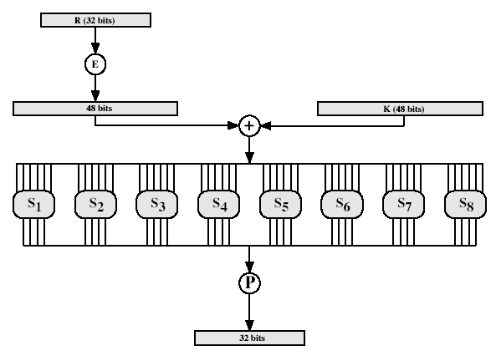
DES Round Structure
Notes:
Note that the s-boxes provide the “confusion” of data and key values, whilst the permutation P then spreads this as widely as possible, so each S-box output affects as many S-box inputs in the next round as possible, giving “diffusion”.

Slide 30
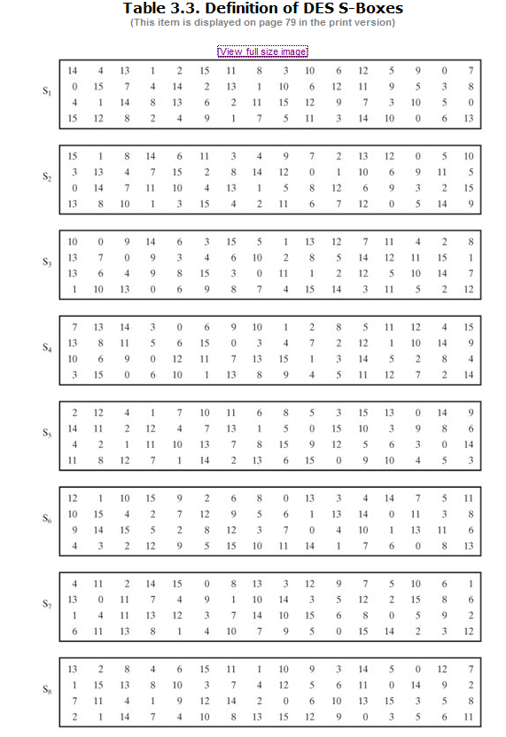
DES S-Boxes

Slide 31
Substitution Boxes S
have eight S-boxes which map 6 to 4 bits
each S-box is actually 4 little 4 bit boxes
outer bits 1 & 6 (row bits) select the row number
inner bits 2-5 (col bits) selects the column number in the table (from 0-15)
The value at that place is a decimal number which is translated into binary (4 bit) to obtain the output of that S-box
For example, in S1, for input 011001, the row is 01 (row 1) and the column is 1100 (column 12). The value in row 1, column 12 is 9, so the output is 1001.
Notes:
The substitution consists of a set of eight S-boxes, each of which accepts 6 bits as input and produces 4 bits as output. These transformations are defined in Table 3.3, which is interpreted as follows: The first and last bits of the input to box Si form a 2-bit binary number to select one of four substitutions defined by the four rows in the table for Si. The middle four bits select one of the sixteen columns. The decimal value in the cell selected by the row and column is then converted to its 4-bit representation to produce the output. For example, in S1, for input 011001, the row is 01 (row 1) and the column is 1100 (column 12). The value in row 1, column 12 is 9, so the output is 1001.

Slide 32
DES Key Generation
a 64-bit key is used as input to the algorithm.
The bits of the key are numbered from 1 through 64; every eighth bit is ignored, so giving 56-bit key
The key is first subjected to a permutation governed by a table labeled Permuted Choice One
The resulting 56-bit key is then treated as two 28-bit quantities, labeled C₀ and D₀.
At each round, C_{i-1} and D_{i-1} are separately subjected to a circular left shift, or rotation, of 1 or 2 bits. These shifted values serve as input to the next round.
They also serve as input to Permuted Choice Two, which produces a 48-bit output that serves as input to the function F(R_{i-1}, K_{i}).

Slide 33
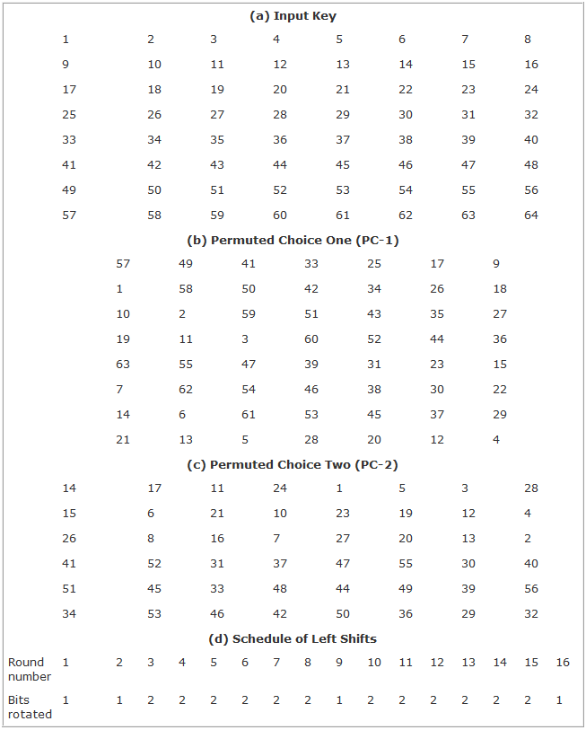
33

Slide 34
DES Decryption
decrypt must unwind steps of data computation
with Feistel design, do encryption steps again
using subkeys in reverse order (SK16 … SK1)
note that IP undoes final FP step of encryption
1st round with SK16 undoes 16th encrypt round
16th round with SK1 undoes 1st encrypt round
then final FP undoes initial encryption IP
thus recovering original data value

Slide 35
Avalanche Effect
key desirable property of encryption algorithm
where a change of one input or key bit results in changing approx half output bits
DES exhibits strong avalanche

Slide 36
Strength of DES – Key Size
56-bit keys have 2⁵⁶ = 7.2 x 10¹⁶ values
brute force search looks hard
recent advances have shown is possible
in 1997 on Internet in a few months
in 1998 on dedicated h/w (EFF) in a few days
in 1999 above combined in 22hrs!
still must be able to recognize plaintext
now considering alternatives to DES
DES finally and definitively proved insecure in July 1998, when the Electronic Frontier Foundation (EFF) announced that it had broken a DES encryption using a special-purpose "DES cracker" machine that was built for less than $250,000. The attack took less than three days. TheEFF has published a detailed description of the machine, enabling others to build their own cracker [EFF98].
Notes:
DES finally and definitively proved insecure in July 1998, when the Electronic Frontier Foundation (EFF) announced that it had broken a DES encryption using a special-purpose "DES cracker" machine that was built for less than $250,000. The attack took less than three days. TheEFF has published a detailed description of the machine, enabling others to build their own cracker [EFF98].

Slide 37
Strength of DES – Timing Attacks
attacks actual implementation of cipher
use knowledge of consequences of implementation to derive knowledge of some/all subkey bits
specifically use fact that calculations can take varying times depending on the value of the inputs to it
Notes:
AES analysis process has highlighted this attack approach, and is a concern.

Slide 38
DES Modes of Operations
&
Double/Triple DES

Slide 39
Modes of Operation
block ciphers encrypt fixed size blocks
eg. DES encrypts 64-bit blocks, with 56-bit key
need way to use in practise, given usually have arbitrary amount of information to encrypt
1. ECB (Electronic code book)
2. CBC (Cipher block chaining)
3. CFB (Cipher feedback)
4. OFB (Output feedback)
5. CTR (Counter method)
Self study
Notes:
DES (or any block cipher) forms a basic building block, which en/decrypts a fixed sized block of data. However to use these in practise, we usually need to handle arbitrary amounts of data, which may be available in advance (in which case a block mode is appropriate), and may only be available a bit/byte at a time (in which case a stream mode is used).

Slide 40
Electronic Codebook Book (ECB)
message is broken into independent blocks which are encrypted
each block is a value which is substituted, like a codebook, hence name
each block is encoded independently of the other blocks
C_{i} = DES_{K1} (P_{i})
uses: secure transmission of single values
Notes:
ECB is the simplest of the modes, where each block is en/decrypted independently of all the other blocks, and is used when only a single block of info needs to be sent (eg. a session key encrypted using a master key).

Slide 41
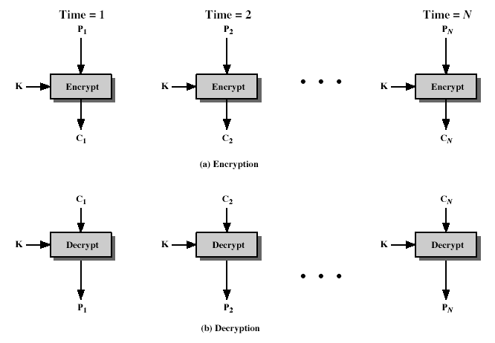
Electronic Codebook Book (ECB)
Notes:
ECB is the simplest of the modes, where each block is en/decrypted independently of all the other blocks, and is used when only a single block of info needs to be sent (eg. a session key encrypted using a master key).

Slide 42
Advantages and Limitations of ECB
repetitions in message may show in ciphertext
if aligned with message block
particularly with data such graphics
or with messages that change very little, which become a code-book analysis problem
weakness due to encrypted message blocks being independent
main use is sending a few blocks of data
Notes:
ECB is not appropriate for any quantity of data, since repetitions can be seen, esp. with graphics, and because the blocks can be shuffled/inserted without affecting the en/decryption of each block.

Slide 43
Cipher Block Chaining (CBC)
message is broken into blocks
but these are linked together in the encryption operation
each previous cipher blocks is chained with current plaintext block, hence name
use Initial Vector (IV) to start process (often all 0’s)
C_{i} = DES_{K1}(P_{i} XOR C_{i-1})
C₋₁ = IV
uses: bulk data encryption, authentication
Notes:
To overcome the problems of repetitions and order independence in ECB, want some way of making the ciphertext dependent on all blocks before it. This is what CBC gives us, by combining the previous ciphertext block with the current message block before encrypting. To start the process, use an Initial Value (IV), which is usually well known (often all 0's), or otherwise is sent, ECB encrypted, just before starting CBC use. CBC mode is applicable whenever large amounts of data need to be sent securely, provided that its available in advance (eg email, FTP, web etc)

Slide 44
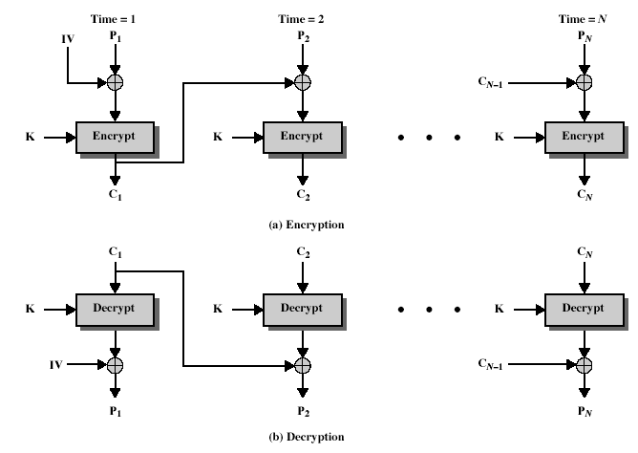
Cipher Block Chaining (CBC)
Notes:
To overcome the problems of repetitions and order independence in ECB, want some way of making the ciphertext dependent on all blocks before it. This is what CBC gives us, by combining the previous ciphertext block with the current message block before encrypting. To start the process, use an Initial Value (IV), which is usually well known (often all 0's), or otherwise is sent, ECB encrypted, just before starting CBC use. CBC mode is applicable whenever large amounts of data need to be sent securely, provided that its available in advance (eg email, FTP, web etc)

Slide 45
Advantages and Limitations of CBC
each ciphertext block depends on all message blocks
thus a change in the message affects all ciphertext blocks after the change as well as the original block (avalanche affect)
need Initial Value (IV) known to sender & receiver
however if IV is sent in the clear, an attacker can change bits of the first block, and change IV to compensate
hence either IV must be a fixed value or it must be sent encrypted in ECB mode before rest of message
Issue: at end of message, how to handle possible last block (if its not complete)
by padding either with known non-data value (eg nulls)
or pad last block with count of pad size
i.e. explicitly have the last byte as a count of how much padding was used (including the count)
Notes:
CBC is the generally used block mode. The chaining provides an avalanche effect, which means the encrypted message
cannot be changed or rearranged without totally destroying the subsequent data.
One issue is how to handle the last block, which may well not be complete. In general have to pad this block (typically with 0's), and then must recognise padding at other end - may be obvious (eg in text the 0 value should usually not occur), or otherwise must explicitly have the last byte as a count of how much padding was used (including the count). Note that if this is done, if the last block IS an even multiple of 8 bytes, will have to add an extra block, all padding so as to have a count in the last byte.

Slide 46
Triple DES
replacement for DES was needed
Theoretical attacks that can break it
Demonstrated exhaustive key search attacks
AES is a new cipher alternative
Prior to this alternative was to use multiple encryption with DES implementations
Triple-DES is the chosen form

Slide 47
Double DES
It does twice what DES does once
Uses two keys
K1 and K2
It performs DES on original Plaintext using K1 to get the encrypted text
It again performs DES on the encrypted text but this time with key K2

Slide 48
K = 00011010101010101010101010010
Single Des Encryption
(K = K₁, K₂, K₃…..K₁₆)
Single des decryption
(K = K₁₆, K₁₅, K₁₄…..K₁)
Double Des:
K1= 00011010101010101010101010010
K2= 00111111000011111111100011010

Slide 49
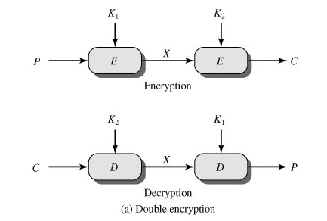
Double DES

Slide 50
Triple-DES with Two-Keys
Hence must use 3 encryptions
Would seem to need 3 distinct keys
But can use 2 keys with E-D-E sequence
C = E_{K1}[D_{K2}[E_{K1}[P]]]
If K1=K2 then can work with single DES
Standardized in ANSI X9.17 & ISO8732
No current known practical attacks

Slide 51
Triple DES with 2 Keys
C =E _{k1}(D_{k2} (E _{k1}( P)))

Slide 52
Triple-DES with Three-Keys
Although are no practical attacks on two-key Triple-DES have some indications
Can use Triple-DES with Three-Keys to avoid even these
C = E_{K3}[E_{K2}[E_{K1}[P]]]
Has been adopted by some Internet applications, e.g. PGP, S/MIME

Slide 53
END

